Slide 1
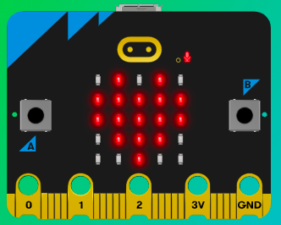
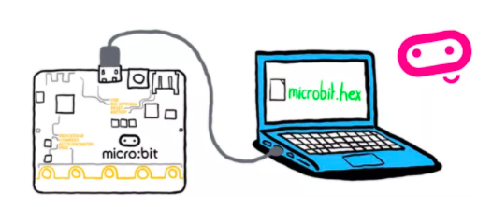
MicroMakers!
KIDS’ MAKER CLUB OF WASHINGTON, DC
Meet Up #14

Slide 2
RECAP!
How many programming languages do you know?
When using your micro:bit with Scratch, how can you make your micro:bit an input? An output?
Notes:
LEDs, Buttons, Light Sensor

Slide 3
FINISHING OUR PROJECTS
Continue working on micro:bit + Scratch game and let your classmates try it out.

Slide 4
RADIO
Let’s Communicate!

Slide 5
What is Radio?
Radio is a way to send electromagnetic signals over a long distance, to deliver information from one place to another. A machine that sends radio signals is called a transmitter, while a machine that "picks up" the signals is called a receiver. A machine that does both jobs is a "transceiver". When radio signals are sent out to many receivers at the same time, it is called a broadcast.

Slide 6
RADIO Projects!
Oh boy, here we go!
Use radio to make a remote sensor sending temperature readings to another micro:bit, for example from outside to inside. You could make an indoor / outdoor thermometer this way.
Make a radio-controlled remote alarm so when you know someone’s turned the lights on – or opened a drawer or bag, and/or when someone has opened the door to your room.
ULTIMATE TREASURE HUNT GAME

Slide 7
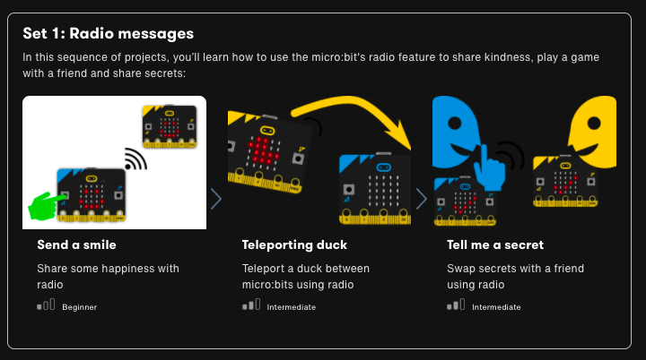

Slide 8


Slide 9
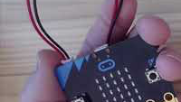
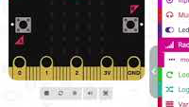
Step 1: The Project Send a Smile
What is it?
Sharing and receiving kindness is a good way to support your well-being and that of your friends. Create a program using radio to send a smile from one micro:bit to another to support a friend
What do I need?
2 micro:bits (or MakeCode simulator) with USBs
MakeCode or Python editor
Battery pack (optional)
A friend to play with

Slide 10
Step 2: How Does it Work?
This program uses the micro:bit's radio feature to share a smile. You can use it in the MakeCode simulator or flash the code on to 2 or more micro:bits.
First, it sets the radio group to 2. Groups are like channels, so any micro:bit using the same group will get the smile. You can use any group number you like from 0-255.
When you press button A, it sends a radio text message 'smile'. It also clears the screen so you can send another smile.
When it receives a radio message, it shows a smile emoji on the LED display.
The combination of radio group and the text of the radio message sent make up a protocol: a set of rules for how two devices communicate.

Slide 11
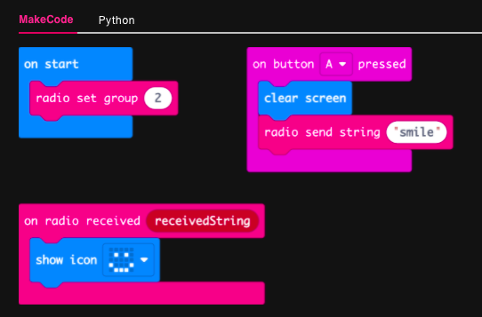
Step 3: Read It and Code It

Slide 12
Step 4: Share Your Creation!

Slide 13
Step 5: Improve It
Customize the smile emoji to your own happy face.
Secret Messages! If you're working in pairs in a class, select your own unique radio group numbers for each pair of students so you can send messages to your partner but not anyone else.
How might you send a different emoji if you press button B?
Advanced: You could also do this by keeping the same radio group, but modifying the code so the text message sent is unique to your pair. Modify the code so it only shows a smile if the correct message is received.

Slide 14
Step 1: The Project Teleporting Duck
What is it?
Make a duck fly invisibly through the air from one micro:bit to another.
What do I need?
2 micro:bits (or MakeCode simulator) with USBs
MakeCode or Python editor
Battery pack (optional)
A friend to play with

Slide 15
Step 2: How Does it Work?
Flash this program onto two micro:bits, shake one and a duck appears to travel magically through the air from one to the other. Shake the other to send it back.
It’s not really magic. It uses the micro:bit’s radio function to send data from one micro:bit to another when the accelerometer detects a shake gesture.
The program first sets the radio group to 23. Groups are like channels on walkie-talkie radios; they can be number between 0 and 255. It doesn’t matter what number you pick as long as your friend’s micro:bit is using the same group number, and no-one else nearby is using the same group.
When you shake it, it sends the word ‘DUCK’ on that radio group and clears the screen. If either micro:bit receives a radio message (any radio message), a duck icon appears on its display, so you should only ever have 1 duck visible at any time.

Slide 16
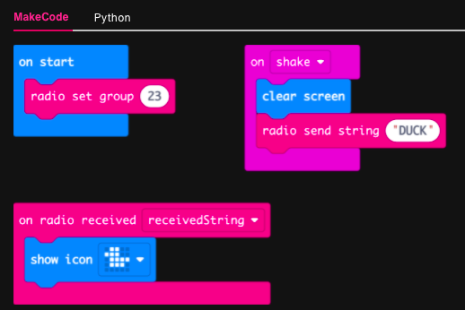
Step 3: Read It and Code It

Slide 17
Step 4: Share Your Creation!

Slide 18
Step 5: Improve It
Find out how far apart you can you go for this still to work.
Teleport other animals. Would you need to change the picture, the message – or both?
Advanced: What happens if more than 2 of you use the same radio group? How can you fix this?

Slide 19
Step 1: The Project Tell Me a Secret
What is it?
Use micro:bit’s radio feature to answer questions in secret.
What do I need?
2 micro:bits (or MakeCode simulator) with USBs
MakeCode or Python editor
Battery pack (optional)
A friend to share a secret with

Slide 20
Step 2: How Does it Work?
Flash this program on to two micro:bits. You and a friend ask each other questions that have ‘yes’ or ‘no’ as the answer.
Press input button A to send ‘yes’ and button B to send ‘no’ messages. A tick or cross will flash on both micro:bits’ LED display outputs for half a second.
The program uses radio to send your answer secretly - no-one (except your partner) can hear the radio signal.

Slide 21
Step 2: How Does it Work?
When a radio message is received, the program uses selection to test the message: if the received message is equal to ‘yes’, then it shows a tick on the LED display, but if the message is equal to ‘no’ then it shows a cross.
Make sure the radio group number is the same on both micro:bits – you can use any number between 0 and 255.
If lots of you are using this program in the same place, you’ll want to make sure each pair of people has their own radio group number.
Keep your radio group number a secret if you don't want anyone snooping on your messages!

Slide 22
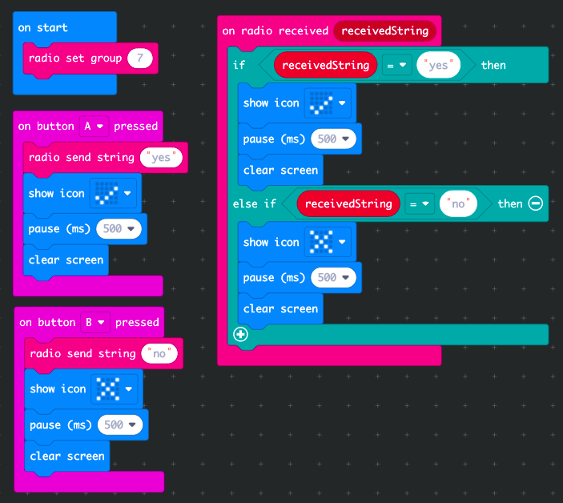
Step 3: Read It and Code It

Slide 23
Step 4: Share Your Creation!

Slide 24
Step 5: Improve It
Show different icons or messages for ‘yes’ and ‘no’.
Use shake, tilt or buttons A and B together to send different answers such as ‘maybe.’
Advanced: Change ‘yes’ and ‘no’ to ‘dot’ and ‘dash’ and send Morse code messages.

Slide 25
BREAK
Hop on one foot 20 times!

Slide 26
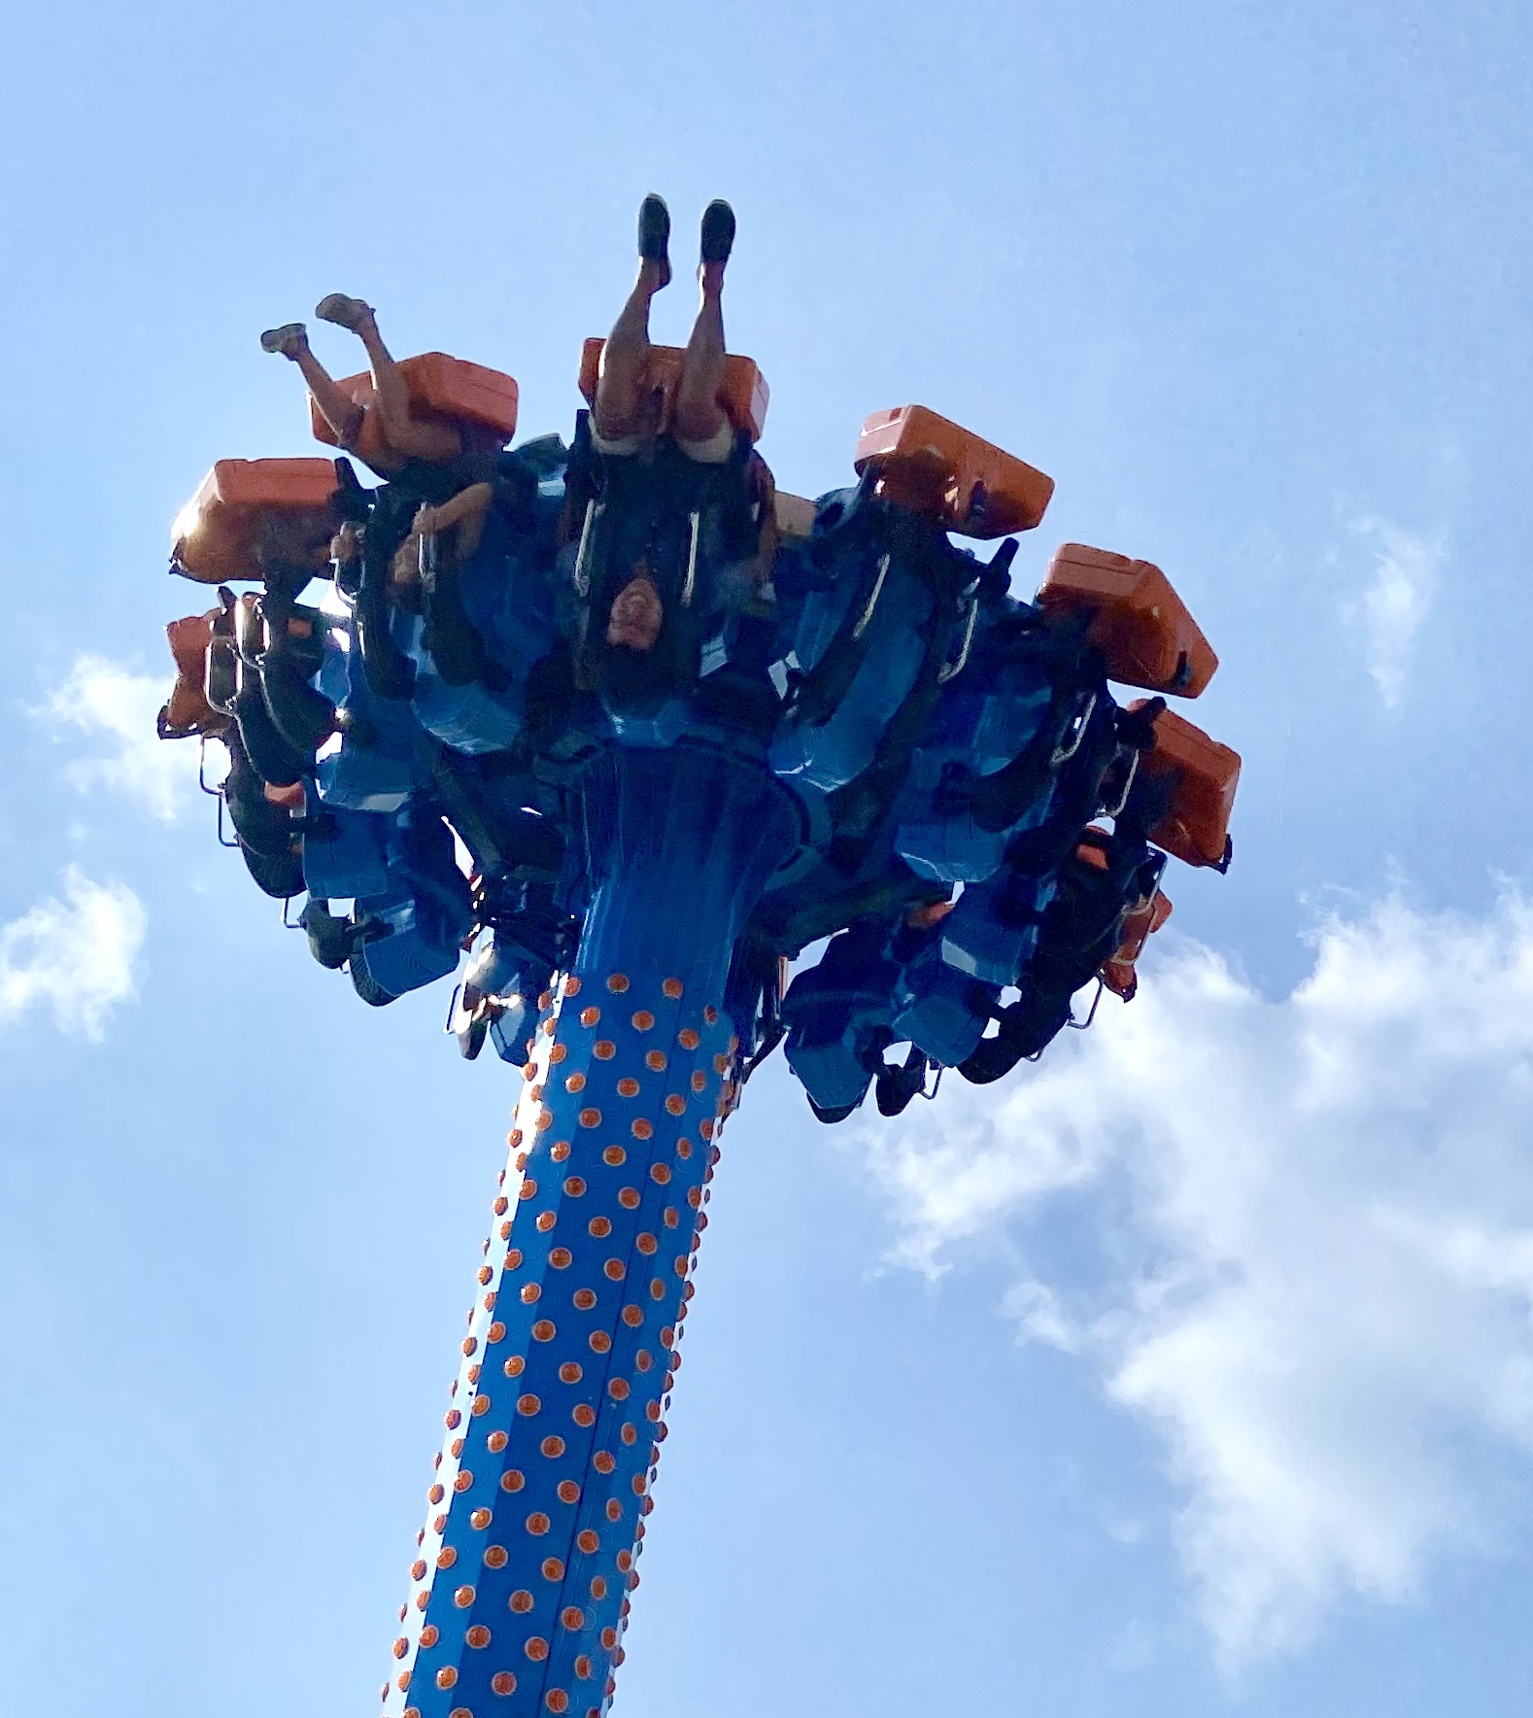
SKILL BADGE
Radio like a boss
YOUR MISSION
Use radio to make a remote sensor sending temperature readings to another micro:bit, for example from outside to inside. You could make an indoor / outdoor thermometer this way.

Slide 27
SKILL BADGE
Remote Control!
YOUR MISSION
Make a radio-controlled remote alarm so when you know someone’s turned the lights on – or opened a drawer or bag, and/or when someone has opened the door to your room.

Slide 28
PROGRAMMING PRACTICE!
Expanding Robot Turtles with Loops, Conditions, and Variables

Slide 29
Coding Building Blocks
Practicing Variables, Loops, and Conditions…with Robot Turtles
Variables
Conditions
Loops

Slide 30
Deep Dive into the Code
Practicing Variables, Loops, and Conditions…with Robot Turtles
Variables
Convert “Forward” to a variable, “Forward = X spaces”. Roll the die on each turn to assign random value to “Forward”
Conditions
If Forward <= 3 spaces, add 1 card (any) to your turn. Else, do nothing.
Loops
While no gem is reached, continue playing the game.

Slide 31
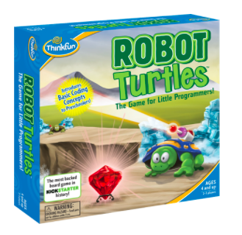
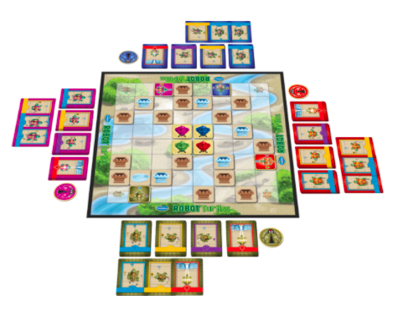
Programming
Let’s Try It!
You tell computers like the micro:bit what to do by giving them instructions. Sets of instructions for computers are called programs. Programs are written in code, a language that both you and the computer can understand.

Slide 32
TIME TO PUT AWAY OUR MICRO:BITS!
Neat and tidy, please!
Let’s leave this beautiful room as lovely as we found it!

Slide 33
NEXT TIME
Sound!!

Slide 34
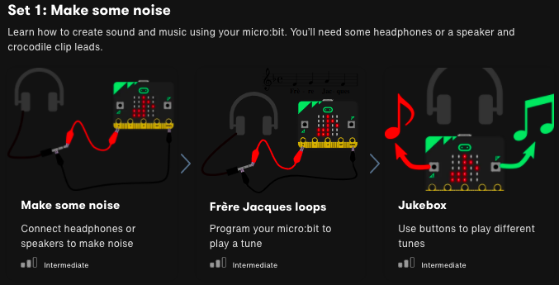

Slide 35
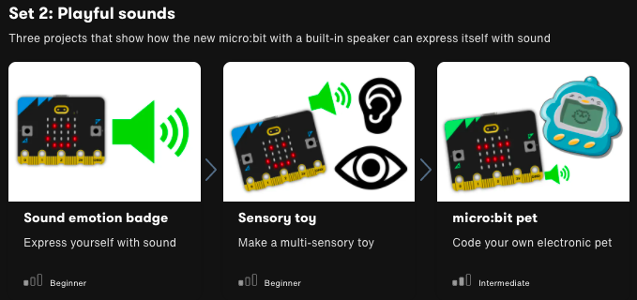

Slide 36
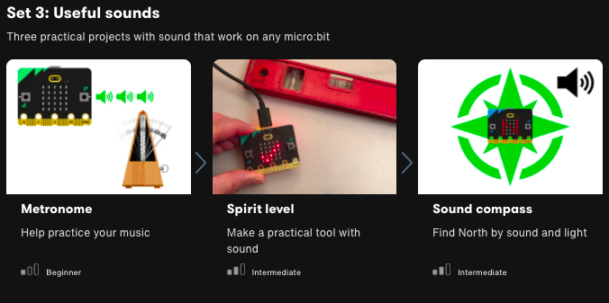

Slide 37

UNTIL NEXT TIME….
MicroMakers!
Slides and Script: Holly Krambeck (learningpython64@gmail.com)
Project Videos, Images, and Text: https://microbit.org/get-started

Slide 38
Extra Slides
BONUS PROJECT!

Slide 39
Step 1: The Project Pass the Duck
What is it?
A group game of ‘hot potato’ using radio – or hot duck!
What do I need?
3+ micro:bits (or MakeCode simulator) with USBs
MakeCode or Python editor
Battery pack (optional)
A group of people to play with

Slide 40
Step 2: How Does it Work?
Like the Teleporting duck game, this uses radio to send a ‘duck’ through the air between micro:bits. That game only works with 2 players as it sends the same message to everyone – soon you would find almost everyone had a duck and anyone could throw one.
If you have more than 2 players each micro:bit needs to have a way of choosing which player will get the duck so each player’s program has a unique ID number, starting with 1.
We store this in a variable called ID, and you’ll need to change this to 2, 3, 4 etc for each player before flashing the program onto their micro:bits.
Set the players variable to the number of people to make sure everyone has a chance of getting the duck. The program shows the player ID number on the LED display at the start so you know who’s got which number.

Slide 41
Step 2: How Does it Work?
To make sure that only the player that has the duck can chuck it, the program only sends a message when you shake it if you have the duck. It keeps track of this using a Boolean variable called hasDuck. Boolean variables can only have two values: True or False. At the start only player 1 has the duck, no-one else can throw it.
When player 1 shakes her micro:bit, the program generates a random number between 1 and the number of players. If the random number is not equal to her own ID number, it sends the new ID number by radio, clears her screen and sets her hasDuck variable to False.
If the random number is equal to her own ID, she’ll need to throw again, but that’s better than the duck being sent to herself – and getting lost in hyperspace!

Slide 42
Step 2: How Does it Work?
If your micro:bit receives a number, it checks to see if it is equal to (matches) your ID number. If it does, congratulations, you now have the duck! A duck appears on your LED display, and your hasDuck variable gets set to True, meaning you can now chuck the duck to someone else.
Please chuck ducks responsibly: make sure you don’t drop your micro:bit or hit a friend in your enjoyment of this game.

Slide 43
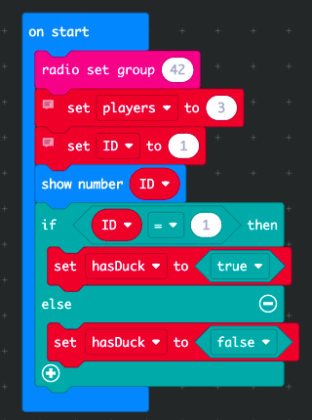
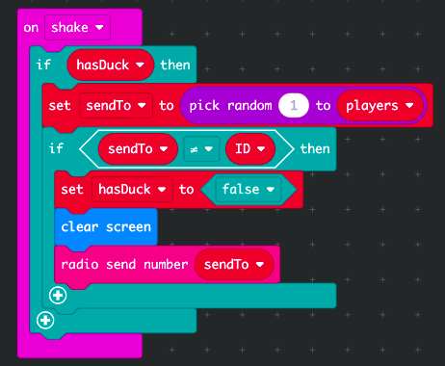
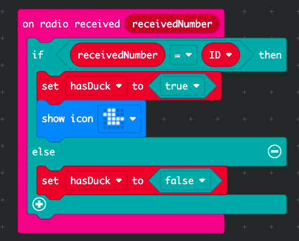
Step 3: Read It and Code It

Slide 44
Step 3: Read It and Code It
What are the variables in this starting block?
What does each variable mean?
What are the possible values for each variable?
With this code, Player #1 starts with the duck. How would we change the code for the other players, so they do not start with the duck?

Slide 45
Step 3: Read It and Code It
What is the input?
What are the variables, what do they mean, and what are the possible values for each?
What does the “pick random” code do?
If this code is on Player 1’s micro:bit, what happens if “sendTo” equals 1? What happens if it is another number?

Slide 46
Step 3: Read It and Code It
What is the input?
What are the variables, what do they mean, and what are the possible values for each?
If this is Player 2’s micro:bit, what happens if receivedNumber is 2? What happens if receivedNumber is something else?

Slide 47
Step 3: Read It and Code It

Slide 48
Step 4: Share Your Creation!

Slide 49
Step 5: Improve It
Change the program to send other things instead of ducks.
At the moment, if it picks a random number that’s the same as your own ID number, you have to shake again. Modify the program so this never happens. There may be more than one way to do this.
Player 1 always has the duck at the start of the game. Could you improve the program so the first player with the duck is chosen at random? How would you communicate this to every player’s micro:bit?

